Slide 1
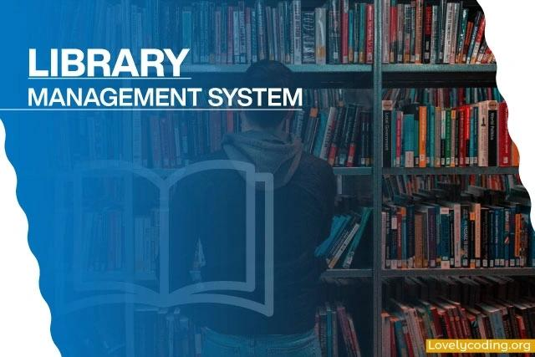

Slide 2

Introduction – What is Library Management?
*Library Management System helps in managing library resources efficiently
It maintains records of books, students, and transactions
Reduces manual work and saves time
Improves accuracy and data organization

Slide 3

Introduction – Purpose of Library Management
To keep track of available and issued books
To manage student/member details
To maintain book return and issue records
To ensure smooth functioning of the library

Slide 4

Introduction – Features of Library Management
Easy book search
Book issuing and returning system
Proper record maintenance
Quick access to information

Slide 5

Benefits of Library Management
Saves time and effort
Reduces paperwork
Increases efficiency
Provides accurate data handling

Slide 6
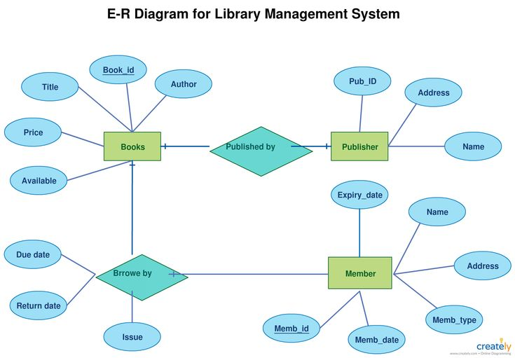

Slide 7
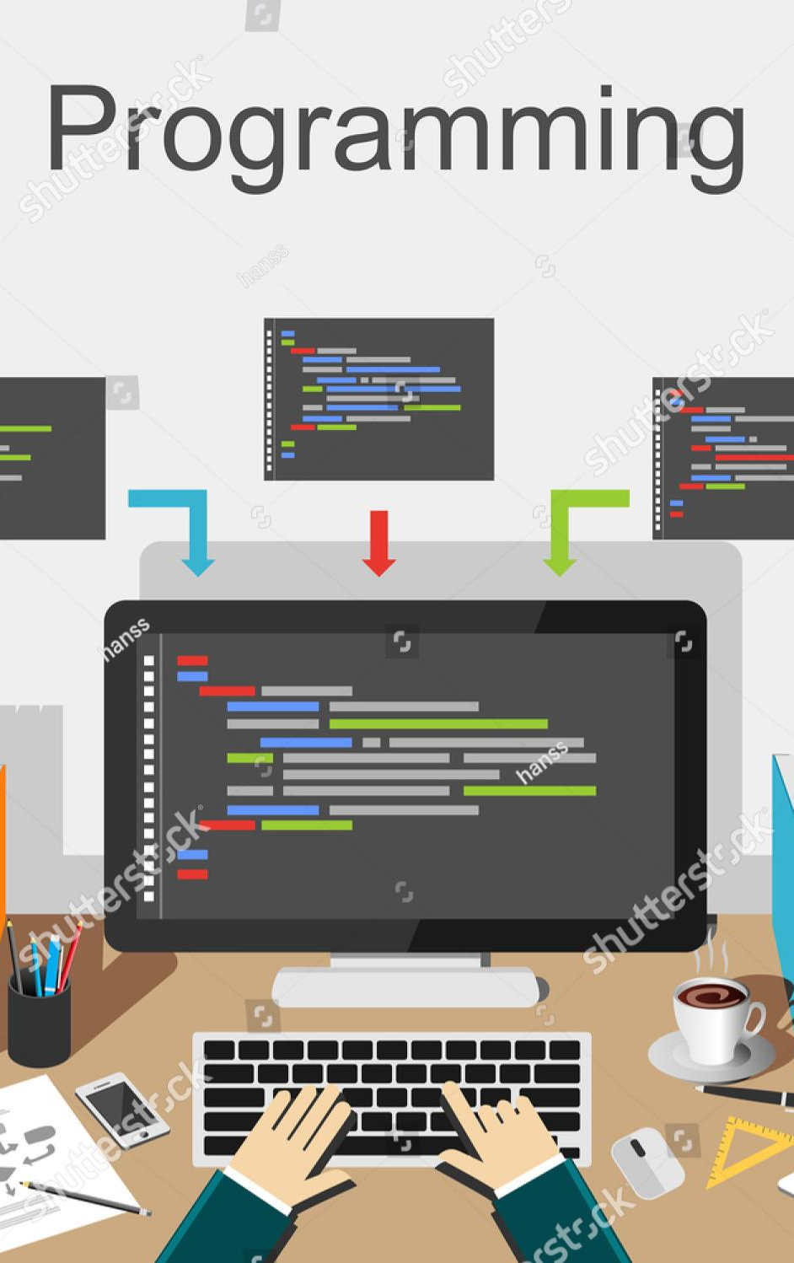
Programming Concepts Used – Structures
Structures are used to store book details
Example details: Book ID, Book Name, Author
Helps in grouping related data
Makes the program more organized

Slide 8

Programming Concepts Used – Loops & Arrays
Arrays are used to store multiple records
Loops help in accessing records repeatedly
Used for searching, displaying, and updating data
Improves program efficiency

Slide 9

Conclusion
The Library Management System plays a vital role in organizing and managing library activities efficiently. It simplifies the process of maintaining book records, issuing and returning books, and managing user details. By using a computerized system, manual work is reduced, accuracy is improved, and time is saved. Overall, a Library Management System enhances the effectiveness of library operations and provides easy access to information for both librarians and users.

Slide 10
Thank you
Team Members
V.Devi sri (25A31A04F5)
V.Dhana Lakshmi (25A31A04f6)
P.satish kumar(25A31A04i6)
P.J.Naveen kumar(25A31a04i7)

